Slide 1
Inclusive Placement Opportunities for Preschoolers: A Systems Approach to Preschool Inclusive Practices
A project of the Virginia Department of Education and the Technical Assistance Centers of Virginia
Notes:
Note to presenter: This module can be changed to reflect the needs of your audience; save the presentation to a location on your computer and make necessary changes.
This module contains activities to promote participant involvement aimed at improving retention of information presented. To learn more about participant-centered training strategies please refer to: Pike, R. (2002). Creative teaching techniques handbook: Tips, tactics, and how-tos for delivering effective training (3rd ed.). Amherst, MA: HRD Press. Or visit the Web site at www.bobpikegroup.com.

Slide 2
Module 6:
Assessment in Early Childhood Inclusive Environments
Notes:
Today we are going to talk about using assessment in early childhood environments.
Since we are concentrating on inclusive classrooms, we will be referencing primarily classes where young children with disabilities are included with peers without disabilities.

Slide 3
Learning Objectives
Participants will learn the purposes of assessment
Participants will review the recommended practices related to the assessment of young children
Participants will learn a process of conducting assessment for the purpose of program planning
Participants will be introduced to assessment tools
Notes:
Review the learning objectives and let participants know if they have questions throughout the day to place them in the parking lot (have sticky notes and a large post it paper so that participants can capture their thoughts/questions).
Note to presenter: Before delivering the content in this module, consider review Assessing Young Children in Inclusive Settings: The Blended Practice Approach by Jennifer Grisham Brown and Kristie Pretti-Frontczak. See entire reference on the last slide in this presentation.

Slide 4
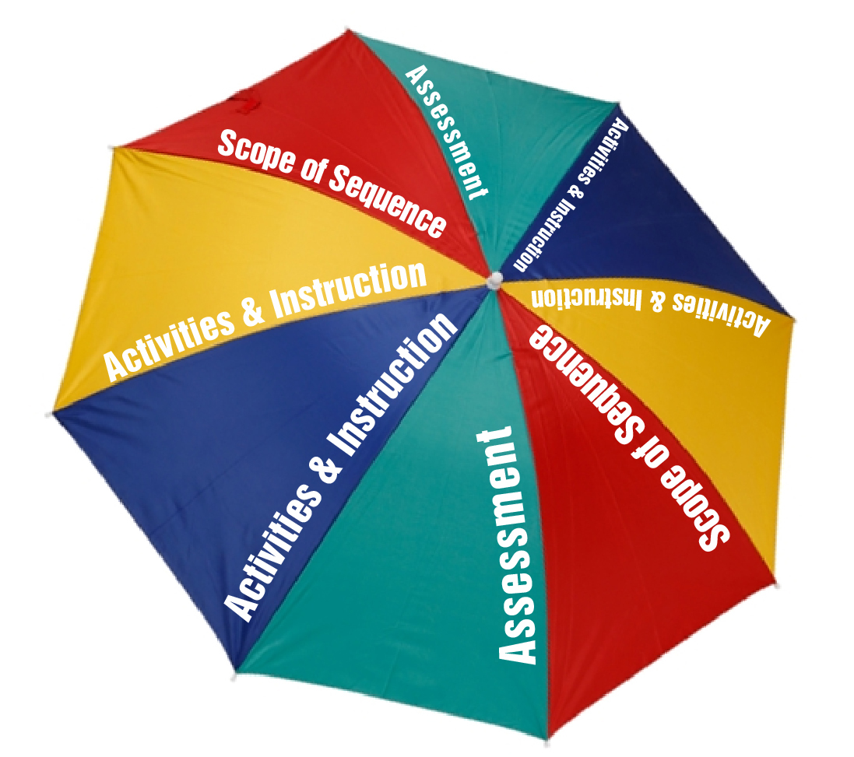
Assessment
Notes:
Assessment is the first panel of the umbrella graphic that shows the elements of a curriculum framework.
To gain more information about a curriculum framework and all of the elements (assessment, scope and sequence, activities & instruction, and progress monitoring) refer to the resources on the last slide of this module.

Slide 5
Assessment (con’t.)
Assessment should be:
authentic
comprehensive and holistic
a baseline of the child’s development
a guide to what to teach children, how to teach them, where to teach them, and who will help
Assessment should tell us:
family resources, priorities. and concerns
the children’s interests and preferences
developmental and content areas
Notes:
Assessment is the process of gathering information for purposes of making decisions (Early Childhood Research Institute on Measuring Growth and Development, 1998, p.2).
Gathering information about all young children in an inclusive classroom is essential to understanding what to teach. This slide shows the descriptors of what the assessment should include and provide.
We will look at each of these descriptors in more detail today.

Slide 6
Assessment Component….
Is comprehensive
Provides baseline information on every child
Identifies children’s interest and preferences
Captures family resources, priorities, and concerns
Guides the development of activities and instruction
Notes:
Review each of the bullets on the slide.
Ask: Participants to share how they have addressed these components when assessing young children.

Slide 7
True or False
Notes:
Activity: Give handout to participants and ask them to do a self-assessment by marking “true” or “false” for each statement. Once completed, review with the group and discuss any items in which there was not consensus.
1) One purpose of assessment in early childhood is to determine students' strengths and set goals for instruction. TRUE
2) Standardized testing environments are the most reliable for young children. FALSE
3) The developmental status of young children, including their ability to focus and self-regulate, makes assessment even more challenging than in other populations. TRUE
4) A teacher who assesses a child should only consider the child’s direct response and not consider the child’s behaviors or any parent report. FALSE
5) An early childhood assessment provides a common ground between educators and parents or families to use in collaborating on a strategy to support their child. TRUE
6) Observations, when used as an assessment practice, can be made with minimal or no intrusion into children’s activities. TRUE
7) Observations should be focused and based on a limited activities. FALSE
8) Although specific methods for assessment tools vary, the process is cyclical in order to allow teachers to make changes to their curriculum. TRUE
9) In an increasingly diverse society, interpretations of assessment results may fail to take into account the unique cultural aspects of children’s learning and relationships. TRUE
10) Decisions about curriculum, assessment practices, and evaluations early education programs are made separately and should not be made complicated. FALSE

Slide 8
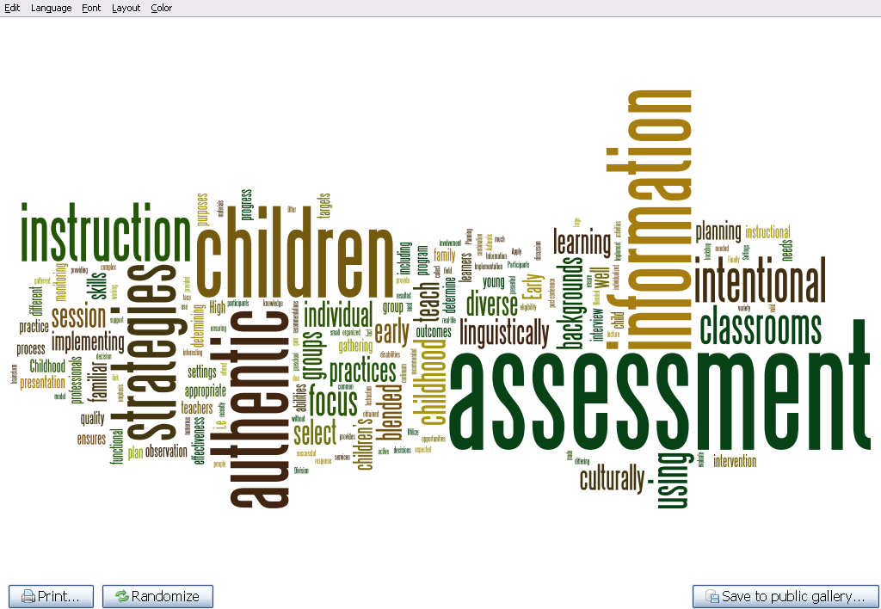
A process of gathering, documenting, summarizing, analyzing, and using information about young children to make decisions
Notes:
This wordle shows all of the components of assessment and the definition of this process.
Note that there are several components within the definitions that stand out. these include gathering, documenting, analyzing, and using.
All are necessary steps in the assessment process.
Many times we gather and document assessment information but fail to really summarize/analyze to help us inform our daily instruction.

Slide 9
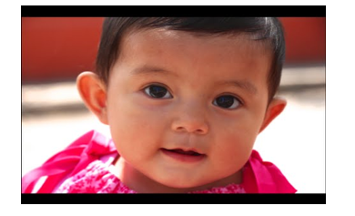
The Purpose of Assessment
Kristie Pretti-Frontzcak, B2K Solutions, Retrieved from https://www.youtube.com/watch?v=TQanyOvGumg&feature=youtu.be
Notes:
Collecting assessment information can serve many purposes.
In this video, Dr. Kristi Pretti-Frontzcak, the owner of B2K Solutions, discusses the reasons we engage in assessment, the purpose of collecting assessment information, and the types of decisions that can be made from each.
Link to video: https://www.youtube.com/watch?v=TQanyOvGumg&feature=youtu.be

Slide 10
Recommended Assessment Practices
Authentic Assessment
Family Involvement in Assessment
Assessing children with diverse abilities
Determining technical adequacy
Notes:
The Division for Early Childhood (DEC) published Recommended Practices in Early Childhood which showcases practices for using with children with disabilities. Asssement is one of the areas.
https://divisionearlychildhood.egnyte.com/dl/tgv6GUXhVo
Note: If participants are not familiar with this resource, you can show them the resource online or have copies.
Also share that the National Association for the Education of Young Children (NAEYC) has published recommended practices around assessing young children: https://www.naeyc.org/resources/topics/assessment
Direct the participants to the NAEYC Web site for additional resources related to the assessment of young children.
Today we will cover the recommended practices listed on the slide (presenter reads each)

Slide 11
Authentic Assessment in Plain English
Familiar people
In familiar settings
With familiar objects/toys
Doing familiar things
Notes:
The first recommended practice around assessment is that it be authentic. This refers to the process of assessing children in their natural environments (home, school, child care center) on functional skills (skills they can use in a variety of environments).
Basically we are talking about assessing children with familiar people. We do this instead of taking children to a separate place, with an adult they do not know, with unfamiliar objects and materials. If we assess children using authentic practices, we can expect them to show us what they can do or know.
Handout: Participants can use the DEC Recommended Practices Performance Checklist for Authentic Child Assessment to increase their understanding and use of the practices.
A full list of the performance checklists can be found at http://ectacenter.org/decrp/type-checklists.asp

Slide 12
Traditional v. Authentic
Administered by those not familiar with the child
Unfamiliar places
Disruptive administration
Assesses skills across developmental domains
Uses test kit materials
Family involvement through receiving information
Administered by those familiar with child
Familiar places
Non-disruptive administration
Assesses functional behaviors
Uses materials that are part of daily routine
Family-multiple roles
Notes:
Clarify the attributes by elaborating on each in the context of traditional/conventional methods of assessment and authentic assessments:
Who Administers:
Traditional - people such as school psychologist, diagnostican, related service providers, teacher not known to child or family
Authentic - the assessment is administered by a familiar teacher, caregiver, related service provider, or family member
Source: Assessing Young Children in Inclusive Settings: The Blended Practices Approach (2011) by Jennifer Grisham-Brown & Kristie L. Pretti-Frontczak.

Slide 13
Authentic Assessment Practices
Involve families in process
Gather information
Plan observations
Know who, what, and how
Conduct observations in familiar settings
Document observations
Notes:
When engaging in an authentic assessment process, it is important to consider the following practices. The slides to follow will discuss each in more detail.

Slide 14
Involve Families in the Process
Notes:
Whenever you are collecting assessment information on young children, an important first step is to involve families. You must consider that the family knows the most about what their child can/can’t do. We must find ways to gather information from them.
Participants can use the DEC Recommended Practices Performance Checklist for Authentic Child Assessment to increase their understanding and use of the practices. A full list of the performance checklists can be found on the Early Childhood Technical Assistance Center (ECTA) Web site. http://ectacenter.org/decrp/type-checklists.asp
Presenter can print checklist ahead of time as needed and share as handouts

Slide 15
Strategies for Involving Families
Notes:
Head Start has six national centers and each one provides valuable information and resources. The Early Childhood Learning and Knowledge Center (ECLKC) has developed materials that early childhood personnel can use to guide their partnership with families. Let’s take a look at a brief video on suggestions for involving and partnering with families in the assessment process. Tell participants to pay attention to the strategies shared on how to involve families in the assessment process.
Activity: After the video, ask participants to turn to a partner and discuss the suggestions that were shared in the video. Have pairs report out and elaborate if they have experience using that particular strategy. Ask them to share their experience using other strategies when partnering with families around assessment.
Link to video: https://eclkc.ohs.acf.hhs.gov/video/partnering-families

Slide 16
Gather Information
Determine who will observe and during which routines
Determine what to observe
Determine how the observations will be done
Notes:
The second step in gathering information in the authentic assessment process is to plan observations of the child. You need to give thought to how you will gather information about a child. Observation is an important way to gather information and should be considered as more than a random recording of a skill or behavior, but as a way of watching an interaction, activity, or event in which a child is engaging. This will allow you to see first hand what the child can do and what skills are needed to help the child gain more skills.
Plan and conduct observations - Be intentional about the observations and determine who, what, and how you will complete them.
Who - Ideally all adults in the room should be involved in observing children to gather assessment information. Develop a schedule for the adults, including instructional assistants and related services providers. Determine during which routines of the day you will conduct the observations.
What - You should determine what you are observing. For example, are you gathering information about how a child interacts with peers, how objects are used in play, or how long the child can stay engaged in a group activity?
How - Determine if the child will be observed individually, in small groups, or large groups. Remember to always observe the child over time, interacting with different people and materials, and in a variety of settings. You will see children acting differently across different circumstances and it is important to know this information for future goal setting.

Slide 17
Gathering Information from Families
When do you….
What do you….
Tell me about a time when….
When you….
How do you know that….
Notes:
Another way to gather information from families is through conducting an “interview” with them.
You could start off by simply asking families to share what happens in their daily routine: “Tell me what happens when you get up in the morning.”
By going through the family routine, you can hear what the child does and what the family member would like him to do. For example, you could ask, “Tell me what your child does during breakfast.”
Once the family shares, then ask, “What would you like your child to do during breakfast?” This allows you to gain information about what the child is presently able to do, but to also hear what is important to the family around their child’s skills within the daily routine so that you can set goals based on this information.
Some other questions that might serve as conversation starters with families are listed on the slide. This information can be collected in a narrative format, allowing families to give more detail about their child’s strengths and needs.

Slide 18
Conduct the Observation in a Familiar Setting
Determine the method for collecting the information observed
Be discreet
Determine what other adults will be doing while one is observing
Notes:
Now that you are ready to conduct the observation, you will need to determine the method you will use to collect and document what you see.
There are many ways to collect the information from your observations and we will discuss those methods in a minute. Remember to be discreet when conducting the observation. You want to gather information about the child's ability in an objective manner. Providing too much encouragement, support, or direction may impact learning more than seeing the child’s true functional abilities.
Before starting the observations, you should also determine the roles and responsibilities of the other adults involved. Observing requires that you sit back and really watch what is going on, without intervening or actively engaging with the child. As teachers this can be hard to do. Therefore, it is important that all other adults know their roles when the observation is taking place. This will allow and give the observer “permission” not to interact in the day-to-day flow of the routines and classroom.

Slide 19
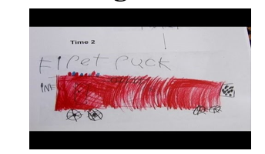
Documenting Child Progress
Center for Early Childhood Education, Eastern Connecticut University, Retrieved from http://www.easternct.edu/cece/e-clip-documenting-childrens-learning/
Notes:
Let’s take a look at video produced by The Center for Early Childhood Education at Eastern Connecticut University on documenting children’s learning within the routines of the day.
Link to video: http://www.easternct.edu/cece/e-clip-documenting-childrens-learning/
After the video, ask participants to answer the following questions:
1. What sorts of things do I regularly document? What areas might I be missing? 2. What methods do I currently use to document children’s learning? What are some new methods I might try? 3. How do my documentation practices help my understanding of children’s needs? How do I use documentation to adjust how I teach and support children? 4. How can I set aside time to ensure that planned documentation happens regularly? How can I plan ahead to ensure that I am prepared to document spontaneous moments? 5. How do I share what I document with families? With other colleagues? With the children themselves? Compare and contrast.

Slide 20
Methods to Document Observations
Written Descriptions
Anecdotal records
Running Records
ABC Analysis
Permanent Records
Counts and Tallies
Notes:
There are multiple ways of gathering and documenting information gained during observation. Let’s discuss each of the methods listed here.
Written descriptions include anecdotal records, running records, and ABC analysis. With all of these examples we must remember that it is important that what is being documented must be measurable and observable. Also remember that when observing, choose natural times during the daily routine to observe the skill you are looking for. For example, if you are wanting to gain more information about a child’s social interactions, observe during the routines of the day where social interactions are more likely to occur (e.g., snack, lunch).
Anecdotal records are brief written accounts of behaviors, events, or activities that record a child’s skill level and are written after the behaviour or event takes place (McNair, et al.,1998). The notes need to be descriptive of what occured, what the observer saw, what was said or heard. They should not include any of the observers thoughts or feelings. An example of a note could be, “J handed the toy to L and said, ‘Can you make this work?’”
Running Records: Running records can be used to gather information about a child. A running record differs from an anecdotal note in that it is more detailed “narrative” of a child’s behavior and generally includes a sequence of events. The observer records the exact details of the interaction or skills being observed. By recording the words and actions, the teacher has a narrative which identifies multiple skills. Once completed, the record can be placed in the child’s permanent folder and used to monitor progress.
ABC Analysis: Antecedent, Behavior, Consequence is a way of gathering information about a child’s behaviors. The Antecedent is what happens directly before a behavior (e.g., what is said or done); the Behavior is the exact behavior the child demonstrates, the Consequence is what happens directly after the behavior occurs (e.g., what is said or done).
Sample of an ABC analysis: Antecedent: Teacher asks child to clean up the play area. Behavior: Child runs from the area saying “No I want to play more.” Consequence: Teacher tells child to go to the quiet area. Recording these observations using an ABC chart helps the observer gather information so the teacher can begin to understand patterns in the child’s behavior and determine the “function” or “reason” that a behavior occurs. If adults can determine the “function” of the behavior (i.e., to obtain, or escape a person, place, or thing), then a plan can be developed to prevent the behavior from happening by meeting the function of the behavior.
Permanent records are used to keep track of children’s data, work samples, and progress over a period of time. This information can be organized through the use of a portfolio. A portfolio can contain samples of a child’s work such as artwork, anecdotal notes, running records, sample writing, pictures/photographs. etc. The portfolio allows for the teacher to store the child’s work in an organized manner. Some methods teachers can use are folders, pizza boxes, files.
Ask participants others ways in which they have collected and stored information for a portfolio
Counts and Tallies are used to track the number of times a behavior occurs. Ways to do this include using checklists time samples, rating scales, and rubrics.

Slide 21
Types of Assessments for Program Planning
Curriculum-based/Embedded Assessments: Assessment and instruction content are identical and integrated
Curriculum-referenced: Compatible with items found in many different curricula and are linkable
Notes:
You can use assessment tools to also collect information on a child.
Curriculum-based Assessment (CBA) is a type of criterion referenced assessment used to measure whether the child meets some previously determined objective. CBAs are typically used for program planning but can also be used for determining eligibility, progress monitoring, and program evaluation.
Assessments must be linked to what the program wants the children to learn.

Slide 22
CBA/CEA to Determine…
Why: Identify strengths, interests, emerging skills/needs
Who: Individual or groups of children
What: To teach individual children/groups of children
How: To provide instruction and support young children and to use curriculum-based assessment measures within the context of the classroom
Where: To provide instruction (interest and preferences)
Notes:
Review the points on the slide and remind participants that for both curriculum-based and curriculum-embedded assessments, the purpose is to collect individual baseline data on every child in a program.

Slide 23
Characteristics of High Quality CBA
Aligns with state/federal standards
Functional goals
Multiple means of expression
Diversity of learners (age and ability)
Comprehensive and Integrated
Family input
Notes:
Aligns with state standards (i.e., VA Foundation Blocks for Early Learning - state standards detailing learning outcomes for 4-year-olds)
Functional goals
Children have a variety of means for responding and demonstrating what they know.
Diversity of learners – allows for children with disabilities to access materials
Includes all dimensions of a child’s development – covers all content areas.
Involves families in all aspects of the assessment

Slide 24
Examples of CBA/CEAs
Assessment and Evaluation Programming System (AEPS)
Carolina Curriculum
Creative Curriculum - Teaching Strategies Gold
High Scope Child Observation Record (COR)
New Portage Guide Three - Six
Hawaii Early Learning Profile
Transdisciplinary Play-Based Assessment
Notes:
Read examples listed on the slide and ask participants if they are familiar with any of these. If so, have them share their experiences using the tools.

Slide 25
Administer Using Recommended Practices
Acceptability
Authenticity
Collaboration
Evidence
Multi-factors
Sensitivity
Universality
Utility
Notes:
Share with participants the resource LINKing Authentic Assessment & Early Childhood Intervention: Best Measures from Best Practices (2nd ed.) by Stephen Bagnato, John Neisworth, Kristie Pretti- Frontczak. This book is a great
resource because the authors have reviewed 81 assessment tools for children birth through 8.
Note: The book should be available from your local T/TAC.

Slide 26
Let’s Review Assessments
Review the CBA/CEA on your table
Refer to the LINKing book and find the page with information about the assessment on your table
Complete the Assessment Chart Handout
Notes:
Activity: Break the participants into groups and have each group rotate and review each of the curricula. Distribute and have the participants complete the handout Chart for Reviewing CBA/CEA Assessments for the assessments they review. Once activity is completed, have participants share out information related to the assessments they reviewed.
NOTE: Have the assessments listed on the slide for participants to review. You can obtain these from your local T/TAC. You can determine your regional T/TAC by going to the following Web site. https://ttaconline.org/

Slide 27
Children with Significant Disabilities
Non-verbal
Blind
Significant cognitive impairments
Deaf or hard of hearing
Limited gross and fine motor ability
Notes:
It is important that we remember to address the assessment needs of children with more significant disabilities as many times these children are considered “untestable.”
This is especially true if you are using a standardized testing tool that requires those doing the assessment to present the item in a certain way. For example, a “test” item might require the child to label, point, or move items to demonstrate a skill.
Activity: Post chart paper around the room and label with one of the bullets at the top. Number the participants off in groups (numbers in group will depend on the number of total participants) and have the groups rotate to each chart and think about ways they could or have assessed young children who are non-verbal, blind, etc. At the end of the activity review the comments on the chart paper.

Slide 28
Analyze Information
Analyzing is a process of inspecting data with the goal of highlighting useful information, suggesting conclusions, and subsequently supporting decisions
Stated differently, analyzing is merely a process of looking at summarized data for patterns and trends
Notes:
Once data is summarized you are ready to analyze. This is the process of looking at the data and highlighting useful information, patterns, and trends.
Patterns are events that reoccur, usually in a predictable manner. An example of a pattern is that everytime a teacher asks a child to come to circle, the child runs to the block area and starts pulling out the blocks. Patterns can illustrate areas of concern or identify a strength. A time that a pattern might identify a strength is when a child is asked to come to circle, and is seen to be compliant and eager to participate when given a transitional item to carry to the circle area. In other words, analyze the information so that it can inform you on where to begin instruction.
Analysis also involves looking for trends. Trends involve the general direction in which a value tends to move (up, down, no movement).

Slide 29
Summarizing Assessment Information
Visual
Graph (e.g., bar, line, pie)
Chart or table
Permanent products
Narrative
Strength statements
Emerging skill statements
Areas of concern statements
Numerical
Total numbers or Percentages
Tallies
Duration
Checklist
Rating Scales
Notes:
29
Source: Grisham-Brown, J., & Pretti-Frontczak, K. (2011). Assessing young children in inclusive settings: The blended practices approach. Baltimore, MD: Paul H. Brookes.
The information you collected during the assessment (both through observations and the use of a CBA/CEA) must be summarized. Summarization using a variety of methods will allow you to make more accurate decisions. Several ways to summarize are listed on the slide. Let’s review each one:
Numerical summaries - There can be so much data collected that reducing and consolidating can help. Numerical summaries can include total numbers, averages and/or percentages. For example, if you are looking at tallies that were taken to show the number of times a child exhibited a particular behavior across a period of time, using a percentage might provide more useful information. However, they should be used along with visual or narrative summaries.
Visual summaries – Graphs, diagrams,and charts can be good ways to represent what was collected during the assessment. Also, permanent products such as writing samples or photos can show what a child can do at a point in time and also serve as a good way to show progress that has been made after instruction.
Narrative - As discussed earlier, you can use many forms of written narratives to collect data. These included anecdotal notes and running records. These can be combined into a report to show a child’s performance across activities and events. As information from CBAs is reviewed, the teacher may write a summary describing a child or a group of children’s strengths.
29

Slide 30
Interpreting
Identifying needs
Prioritizing
Matching Instruction
Notes:
Now that you have gone through the process of gathering, documenting, summarizing, and analyzing data, you need to interpret what the data is telling you. In other words, you need to make sense of all of the information you have gathered to help information the instruction that will be provided to the child.
The types of decisions made from interpreting the information we have discussed throughout this module are designed to guide instruction which leads you to who needs to learn what, if certain outcomes are a higher priority than others, and what type and level of instruction is needed.
Before you go further in interpreting the information gathered, you should ask if the interpretations that you are making are based on sufficient and accurate data. See page 170, diagram 7.4 in Grisham-Brown, J., & Pretti-Frontczak, K. (2011). Assessing children in inclusive settings: The blended practices approach published byPaul H. Brookes.

Slide 31
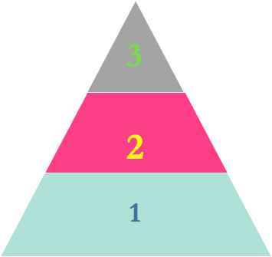
Identifying, prioritizing needs
Notes:
Keep in mind regardless of how information was gathered or how the information was summarized, that if it is not used to make decisions about instruction then it was a waste of time. This is when you need to ask, who needs to learn what, which skills, concepts and dispositions are a priority, and how to match instruction to the identified need.
Let’s take a look at identifying needs which could be needs for an individual child or a group of children. One way that might be helpful in doing this is using a tiered model such as the one displayed here in the pyramid showing three tiers.
Tier 1 - Refers to the instruction is what all children need to learn. It is generally determined from federal outcomes, state learning standards (Virginia’s Foundation Blocks for Early Learning: Comprehensive Standards for Four Year Olds http://www.doe.virginia.gov/early-childhood/curriculum/index.shtm) and generally what is considered age and developmentally appropriate for a given age group. If a child’s needs are identified as Tier 1 instruction, then think about this as meaning generally the child’s development and growth are considered “on track.”
Tier 2 - Instructional needs in this area generally mean the child or children have stalled in their growth around certain concepts or skills that are taught in Tier 1 instruction. In other words, that child/children have the foundation skills or prerequisites needed but they need more targeted instruction to help them acquire the missing components.
Tier 3 - If the instructional needs are in this tier, it is generally because a child may be missing a foundational or prerequisite skill or concept that is keeping him from making progress toward the common outcomes that all are instructed in (Tier 1) .

Slide 32
Identifying Needs
Foundational/prerequisite skill: recognizing numbers, memorization
and recall
Component skill of counting 1:1 correspondence
Counts forward to 20
Notes:
Let’s take a look of one example of sorting a child’s needs based on a tiered approach.
Virginia’s Foundation Blocks for Early Learning: Comprehensive Standards for Four-Year-Olds (http://www.doe.virginia.gov/early-childhood/curriculum/index.shtm) lists a math standard for a 4-year-old being able to count forward to 20.
However in order to do this skill, the child must have some component or underlying skills before he can count to 20. For example, he needs to understand 1:1 correspondance. One-to-one correspondence is being able to use this knowledge to skillfully count an actual number of objects. A child who understands one-to-one correspondence knows that 2 cookies = 2 or that 5 raisins = 5. Saying “1,2,3,4,5" but skipping an object, or counting an object twice, is not 1:1 correspondence. Children need many opportunities to practice saying one number with one object. Also, during the preschool years, children begin to recognize and write numerals.
In Tier 3, the foundational skill that might be missing is the ability to recognizing numbers from one to 20. In order to count forward to 20 (the standard) children need to learn the number names as well as recognize the number symbols.

Slide 33
Prioritizing Needs
Foundational/prerequisite skill: recognizing numbers, memorization and recall
Component skill of counting 1:1 correspondence
Counts forward to 20
Notes:
Once needs have been identified, you might see that several children in the class have similar instructional needs (Tier 2 or 3) or that you have children needing all levels of instructional needs. In this case it is important to prioritize these since it is hard, if not impossible, to provide instruction to address higher level instructional needs when multiple children need Tier 1, 2, and 3 needs.
When prioritizing, think about which outcomes will benefit the child not only to make progress in the classroom, but also at home and in the community. There are several ways to prioritize skills:
Developmental sequences - In which order skills and concepts need to be taught and learned according to development
Pedagogical sequence refers to sequences that are based on research and experience and tell how to best teach a particular skill or concept
Logical sequences may not follow a development or pedagogical sequences but occur as the teacher recognizes a necessary place for instruction to begin

Slide 34
Matching Instruction
Individualized, intensive and intentional
Targeted instruction (additional learning 0pportunities)
General Curriculum-
focus for all children
Notes:
Now the teacher needs to determine the type and frequency of instructional efforts that need to be used. Keep in mind that the level of intensity of instruction should match the child’s needs.
Tier 1 - contains all the general education concepts/skills that need to be taught to all. Most of the time children can learn these skills through incidental instruction either at home or in the classroom setting. In this Tier, instruction is not individualized but universally provided to all children within the context of the daily routine. Examples here are talking about numbers, colors, shapes, and social-emotional skills across the routine.
Tier 2 - skills needed to be acquired by a child or a group of children where instruction needs to go further than just exposure as in Tier 1. In Tier 2, targeted instruction which will require additional learning opportunities, scaffolding the instruction, and more opportunities to practice the skill learned.
Tier 3 - If the child or children do not acquire the skills in Tier 1 or Tier 2, instruction needs to be more intentional, intensive, and individualized. Generally, children who have a disability and consequently have an Individualized Education Program (IEP) developed need instruction at the Tier 3 level. The IEP will have goals and objectives that outline how often the instruction will take place, where the instruction will take place, and what the specially designed instruction will look like.

Slide 35
Resources
DEC Recommended Practices: http://www.dec-sped.org/dec-recommended-practices
ECTA Web site: Screening, Evaluation, and Assessment http://ectacenter.org/topics/earlyid/screeneval.asp
ECTA Web site: Improving Systems, Practices, and Outcomes - Performance Checklists http://ectacenter.org/decrp/type-checklists.asp
ECTA Web site: Recommended Practices - Assessment Checklists http://ectacenter.org/decrp/topic-assessment.asp
Notes:
If you are interested in learning more about the assessment process, please refer to the resources listed here.
Note: For more about instruction, see Module 8 - Embedded Learning Opportunities.

Slide 36
References
Bagnato, S.J., Neisworth, J.T., & Pretti-Frontczak, K. (2010). LINKing authentic assessment and early childhood intervention: Best measures for best practices (2nd ed.). Baltimore, MD: Paul H. Brookes.
Grisham-Brown, J., & Pretti-Frontczak, K. (2011). Assessing children in inclusive settings: The blended practices approach. Baltimore, MD: Paul H. Brookes.

Slide 37
Thank You!
If you have any questions about the content in this module or need further assistance implementing a systems approach to early childhood inclusive practices, please contact the early childhood staff at the following T/TACs.
Regions 1 & 8 VCU 804-828-6947 or 434-292-3723
Regions 2 & 3 ODU 757-683-4333
Region 4 GMU 703-993-4496
Region 5 JMU 540-568-6746
Regions 6 & 7 VT 540-231-5167

